Slide 1
Experimental Designs

Slide 2


Between-subjects experiments
Each participant is tested in only one condition.
Sleep & Cognition – One group gets 8 hours of sleep, and one group gets 4 hours of sleep.
Groups should be similar on various dimensions (Gender, IQ, motivation, physical health, etc.)
8 hours
4 hours

Slide 3
Random assignment
Random assignment – a random process to decide which participants are tested in which conditions.
Random sampling – method for selecting a sample from a population in a way that everyone has an equal chance of being selected.
2 criteria for random assignment
Equal chance of being assigned to each condition
Each participant assigned independently of all other subjects.
Coin Flip; Computerized random number generator.
Unequal sample sizes

Slide 4
Random assignment
Participant | Condition
1 | B
2 | C
3 | A
4 | C
5 | A
6 | B
7 | A
8 | C
9 | B
Block 1
Block randomization
All conditions occur before they are repeated
Within each block, conditions are randomized.
Block 2
Block 3

Slide 5
Random assignment
Participant | Condition
1 | A
2 | B
3 | A
4 | B
5 | A
6 | B
7 | A
8 | B
9 | A
With only two designs, a simpler way could be to alternate conditions
Not knowing who the subject might be, alternating between A & B

Slide 6
Matched-Group Design
Participants in various conditions are matched on the DV or on some extraneous variable prior to manipulating independent variable.
Helps to guarantee that other factors won’t be confounds across conditions.
Example: Sleep & Cognition.
Worried about IQ being different across conditions
Step 1: Measure IQ and rank order subjects
Step 2: Take those scores and assign to groups.
Participant | IQ | Condition
1 | 130 | A
2 | 127 | B
3 | 118 | A
4 | 117 | B
5 | 115 | A
6 | 109 | B
7 | 108 | A
8 | 108 | B
9 | 102 | A
10 | 98 | B

Slide 7
Within-subjects Design.
Each participant is tested in ALL conditions.
Between-Subjects
Within-Subjects
8 hours
4 hours
8 hours
4 hours

Slide 8
Within-subjects Design.
Advantages
Control over extraneous variables
Need fewer people
Disadvantages
Could guess the experimental hypothesis
Order effects

Slide 9
Order Effects
Order effects – when responses in various conditions are affected by the order of conditions subjects are exposed to.
Carryover effect – effect of being tested in one condition on behavior later on.
Practice effect – participants perform tasks better over time due to practice
Fatigue effect – participants perform worse over time due to becoming tired or bored.
Context/Contrast Effects – when one condition can change how participants perceive stimuli or interpret their task
A
B
C
D
A
B
C
D

Slide 10
Counterbalancing
Solution to order effects. Counterbalance – test different participants in different orders.
Complete counterbalancing
ABC
N = 3
ACB
N = 3
BAC
N = 3
Total N = 18 participants
BCA
N = 3
CBA
N = 3
CAB
N = 3

Slide 11
Counterbalancing
Randomize order.
Condition | rand_num
A | 56
B | 69
C | 43
D | 92
E | 77
F | 96
G | 65
H | 5
Condition | rand_num
H | 5
C | 43
A | 56
G | 65
B | 69
E | 77
D | 92
F | 96
Sort by random number

Slide 12
A couple notes on within-subjects
Simultaneous within-subjects design
Multiple responses in each condition
Common in Cognitive Psychology
Longitudinal Designs
Time is a factor, and participants perform a task over multiple days, weeks, months, years
Common in Developmental Psychology
Attrition
In within-subjects designs, and especially longitudinal research, over time people will drop out of your study, and your sample size will get smaller.
Attrition for various reasons. Plan your sample size accordingly.
Condition A (50 trials)
Condition B (50 trials)
Week 1 - score
Week 2 - score
Week 3 - score
Week 4 - score

Slide 13
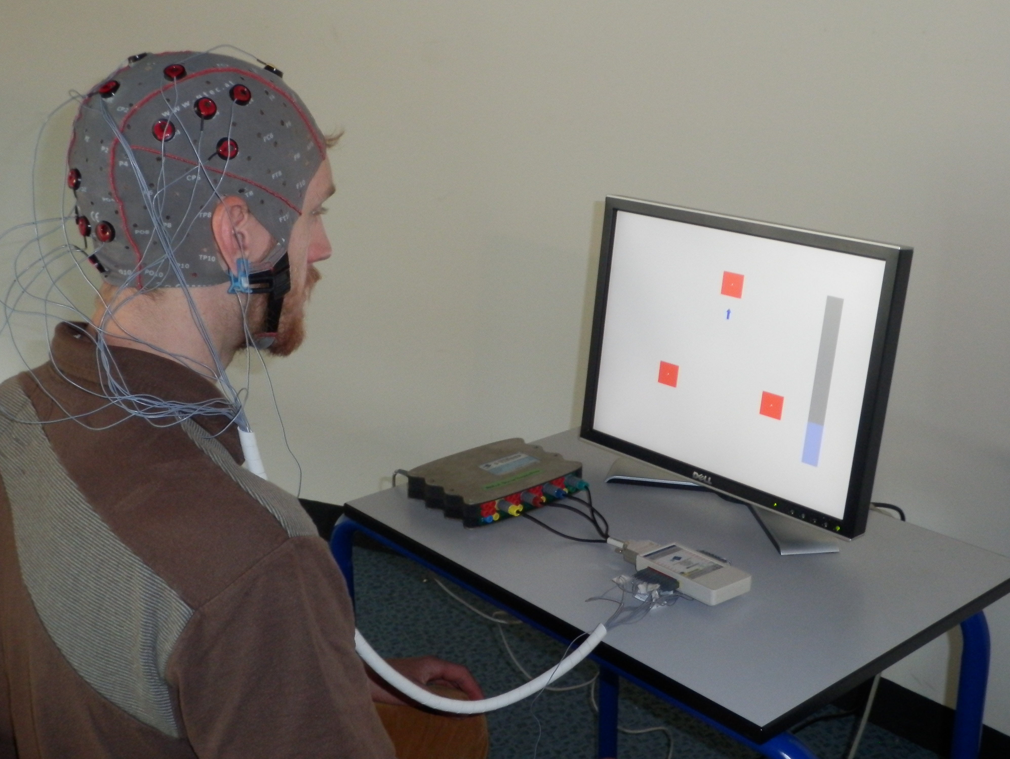
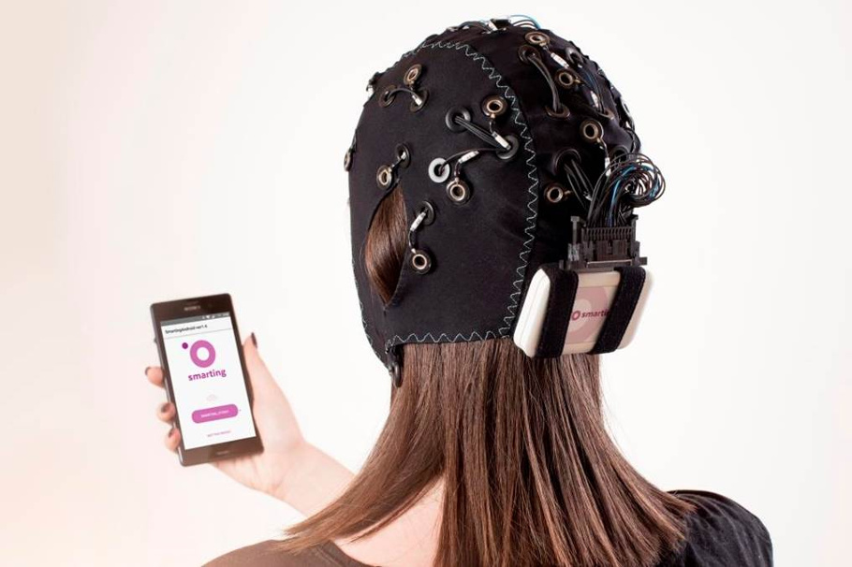
Experimentation and Validity
Internal Validity
High if the way it was conducted supports the conclusion that the IV caused differences in the DV. Manipulated an IV while having tight experimental control of outside factors – (e.g. running experiment in a controlled lab setting).
External Validity
High if the way it was conducted supports generalizing the results to people and situations beyond those actually studied – (e.g. running experiment outside of a controlled lab setting).

Slide 14
Experimentation and Validity
Construct validity
Quality of its manipulations. Does it speak to the research question?
Statistical validity
Proper statistical treatment of data. Soundness of statistical conclusions.

Slide 15
Practical Considerations
How to recruit subjects?
Subject pool
Online workers
Good old fashion recruiting

Slide 16
Practical Considerations
Standardize your procedures.
Experimenter expectancy effects – if experimenter expects participants to be in a treatment group or to perform better than a control group, he/she might unintentionally give them clearer instructions or encourage them.
Have clear written protocols, automate procedures, train experimenters
Blind experiments
Single-blind
Double-blind

Slide 17
Practical Considerations
Testing experiments
2 Experimental groups
Test differences in means
T-test
More than 2 experimental groups
Test for overall differences
Analysis of Variance (ANOVA)
Then test specific differences between groups.

Slide 18
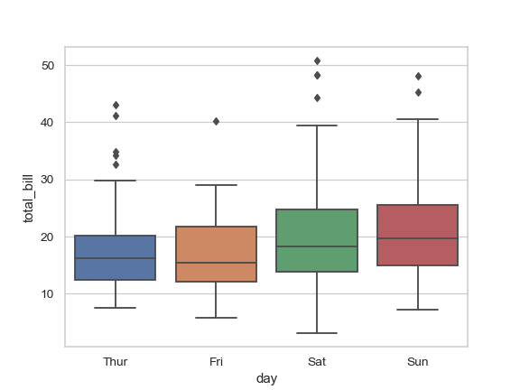
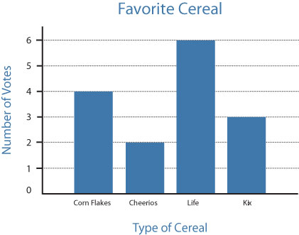
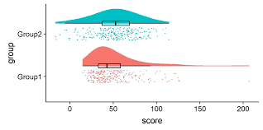
Practical Considerations

